Slide 1
Verification and System Verilog Session 1: Introduction
amr.alaa@guc.edu.eg
C3.305 (Back office)
Sandy.abdelmalak@guc.edu.eg
Reference: Verification guide

Slide 2
Terminology
Testing: Assuring that the product behaves correctly
Validation: Assuring that a product meets the needs of the customer
Verification: The evaluation of whether or not a product complies with the specifications

Slide 3
VLSI Design Flow
Specifications
Architectural Design
Functional Design
Circuit Design
(Synthesis)
Physical Design
Fabrication
Packaging and Testing
Chip

Slide 4
Verification
The process of assuring correct functionality for the design against all possible test cases.
Verification is essential to assure that the design will meet all the specifications and will not lead to unexpected behavior.
Verifications Aspects:
Functional Verification
[Static Verification – Functional Stimulation – FPGA Prototyping – Emulation - UVM]
Timing Verification
[Static Timing Analysis – Timing Simulation]
Notes:
+ Definition and Importance of the verification environment.
+ Types of verification:
1] Functional Verification: It is the process of demonstrating the functional correctness of a design with respect to the design specifications. [Static Verification – Functional Stimulation – FPGA Prototyping – Emulation - UVM]
2] Timing Verification consists of validating the path delays and checking the clock pulses to meet the design goals [Static Timing Analysis – Timing Simulation] + [Hold and setup time]
Dynamic – driving the inputs of the DUT (design under test) and checking if the value on the outputs and selected points is as expected. Done from unit level to full system level, from RTL phase through gate-level to post silicon
Formal – mathematical way to analyze the design and check if the behavior is as expected
Static – tools that verify the coding style
Timing – STA (Static timing analysis):
Verifying that all path are meeting timing requirements (setup/hold) at all relevant corners (PVT) and modes (test modes)
Setup: Verify that the data at the input of each flip-flop is stable at least for “setup time” before the rising edge of the clock
If the data can will not be stable before that time, wrong data might be sampled by the flip-flop and lead to logic failure
Hold: Verify that the data at the input of each flip-flop is stable at least for “hold time” after the rising edge of the clock (the data from the cones is not propagating too fast)
If expansion time from source flop to destination flop is less than the hold time, the value might effect the next flop in the logic cone one cycle earlier
PVT: The expansion time of the data is different in each PVT mode. STA must be check in each mode
For example: At FF corner, 125C degree, 10% more than nominal voltage path A is the longest in flip-flop X cone, but in SS corner, -40c, 10% less than nominal voltage, path B is the longest

Slide 5
Verification

Slide 6
Verification Environment
Functionality of the Test-bench / Verification environment,
Generate stimulus
Apply stimulus to the DUT
Capture the response
Check for the correctness
Measure progress against the overall verification goals

Slide 7
Features for HVL
HVL: Hardware Verification Language (i.e. System Verilog)
Distinct features for HVL:
Constrained random stimulus generation
Functional coverage
Object oriented programming
Support for HDL types (i.e. four state values)
Notes:
Four state values: 1, 0, Z and X
1 and 0 stand for boolean true and false
Z stands for high impedance or open circuit
X stands for don't care

Slide 8
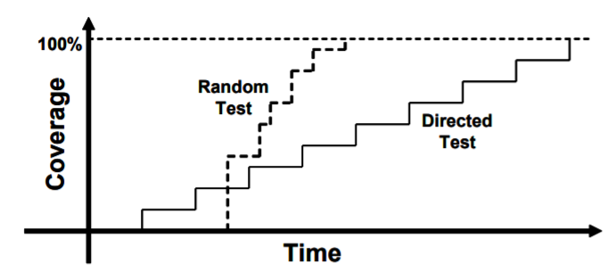
Testing Techniques
Direct Testing
An incremental approach that tests related features at a time
Constrained random testing
Random test scenarios until full coverage is achieved

Slide 9
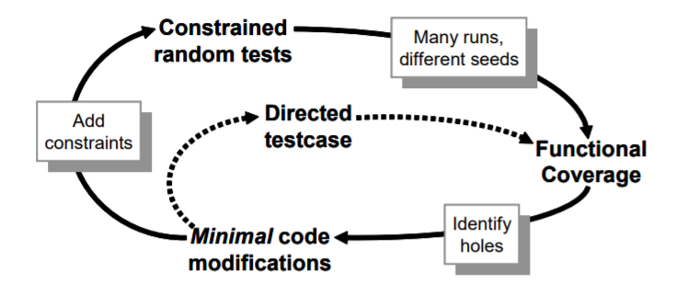
Testing Cycle

Slide 10
Randomization
What should be randomized?
Data Fields (Inputs)
Device and environment configurations
Exceptions, errors and violations
Delays and synchronizations
Notes:
You should randomize the entire environment configuration, including the length of the simulation, number of devices, and how they are configured.
Two signals are mutually exclusive→ Drive them both and make sure the device continues to operate.
Try to coordinate the various drivers so they can communicate at different relative timing.

Slide 11
Session 1 outline
Verification could be done using different languages. The most common language used in Verification is System Verilog.
Introduction to System Verilog: Session 1 will cover basic System Verilog syntax
Examples for each discussed syntax
Mini-Task at the end of the session

Slide 12
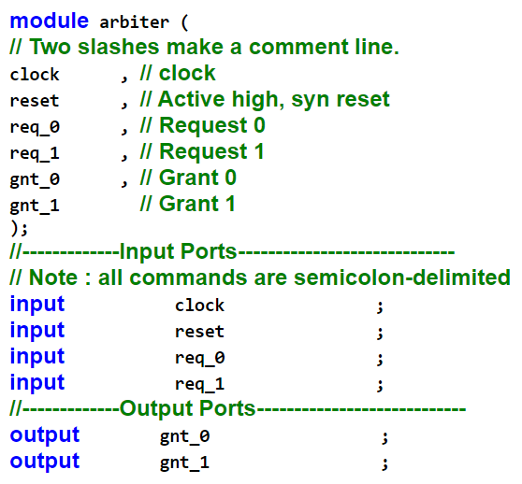
VHDL to Verilog
Verilog code is divided into modules → Inputs and outputs should be defined

Slide 13
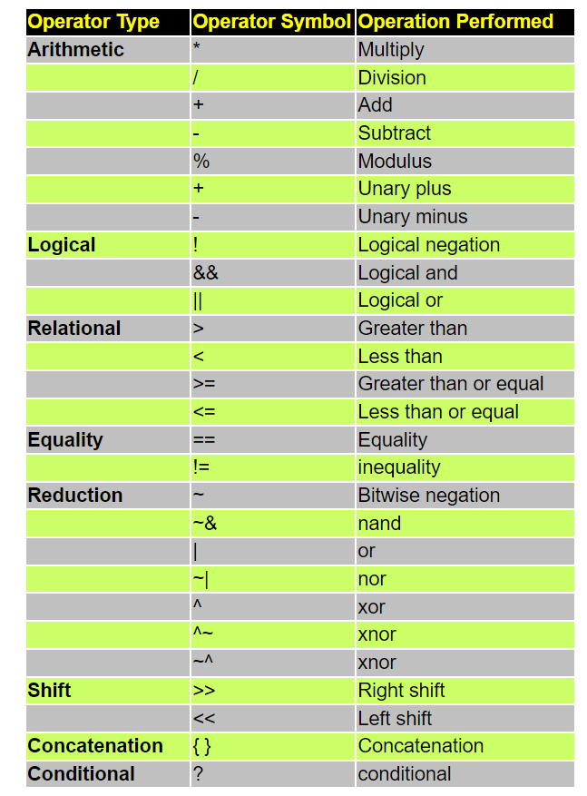
Operators

Slide 14
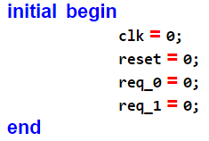
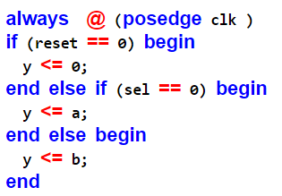
Blocks
Initial Block: It is is executed only once when simulation starts
Always Block: Executes all the time → it must include a sensitivity list or a delay

Slide 15
Data Types
Structural Data Types: model hardware connections between circuit components
Wire: Acts as real connections in circuits
Reg: Hold their values until another value is put on them, just like a register hardware component.
Behavioural Data Types:
Integer: declares variables of type integer
Real: declares real variables stored as 64 bit quantities
Time: Used to hold simulation time (64 bits) → simulation only
Parameters: Represents Constants
Logic: Improved version of Reg, as it can be a variable
Notes:
Structural data types called nets, which model hardware connections between circuit components. The wire nets act like real wires in circuits. The reg type holds their values until another value is put on them, just like a register hardware component.
The declarations for wire and reg signals are inside a module but outside any initial or always block
Data types
Drivers → Data type that drives a load
Driver that can store a value (Flip Flop) → reg
Driver that connects two points → wire

Slide 16

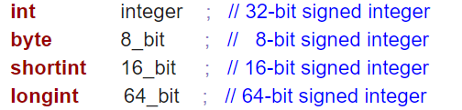
Data Types
Two-State types [0,1]:
bit --- unsigned -- [size is user defined]
byte, shortint, int, longint --- Signed / Unsigned– [8, 16, 32 & 64]
Declaration Example:
Signed Declaration

Slide 17
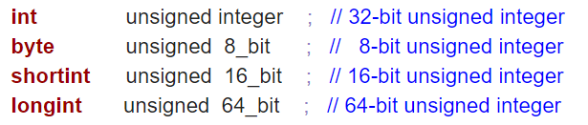
Data Types
Declare unsigned from signed type:
Void Data Type: used as the return type of a function

Slide 18
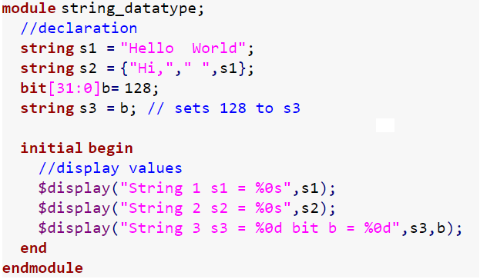
Data Types
String – Example:
String 1 s1 = Hello World String 2 s2 = Hi, Hello World String 3 s3 = 128 bit b = 128
Notes:
// --- String declaration and usage ---
module string_datatype;
//declaration
string s1 = "Hello World";
string s2 = {"Hi,"," ",s1};
bit[31:0]b= 128;
string s3 = b; // sets 128 to s3
initial begin
//display values
$display("String 1 s1 = %0s",s1);
$display("String 2 s2 = %0s",s2);
$display("String 3 s3 = %0d bit b = %0d",s3,b);
end
endmodule

Slide 19
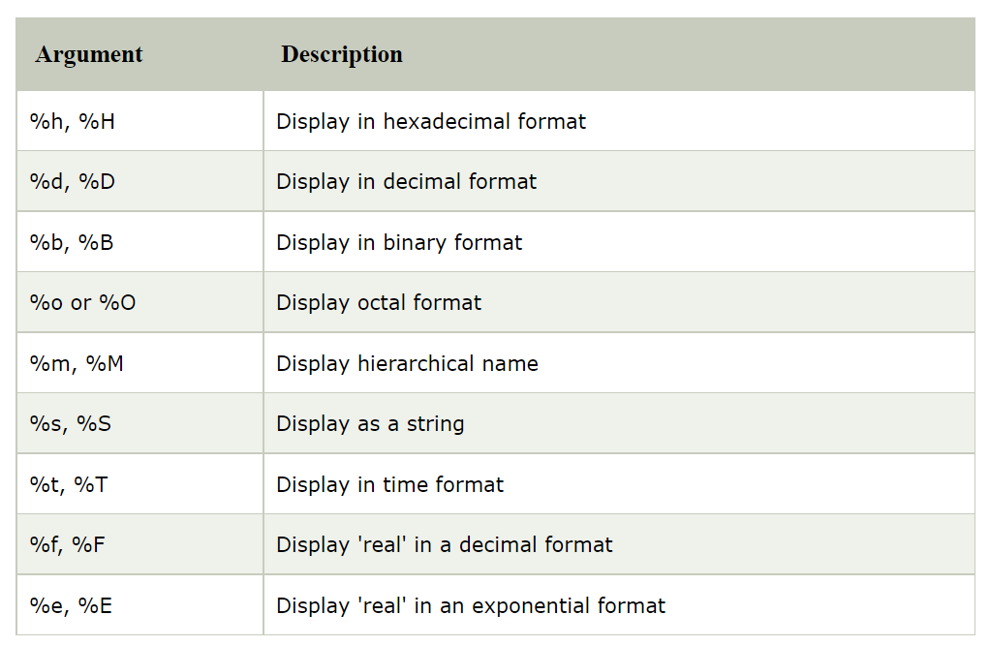
Display Options

Slide 20
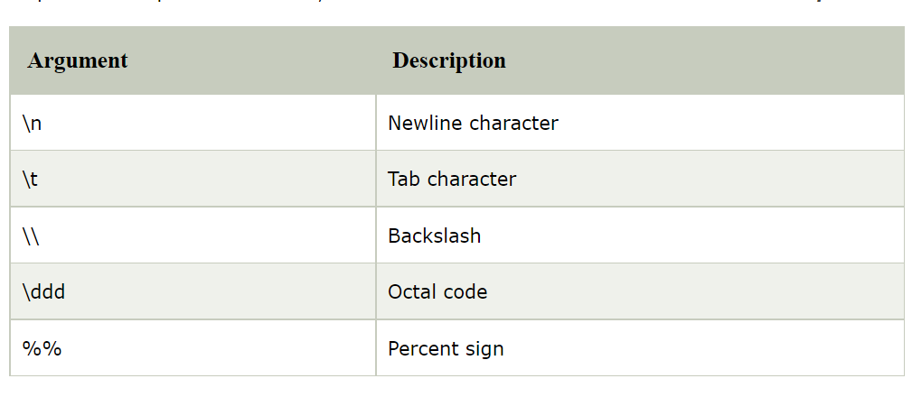
Display Options

Slide 21
Data Types
Enumeration / Enum: defines a set of named values → enhance readability → state machines
Examples:
0,1,2,3,4,5
0,1,4,5,10,11
Syntax error
Notes:
The actual values are defaulted to integers starting at 0 and then increase. in the above example by default variable will get the default value of 0,1,2,3,4,5 respectively from red. The values can be set for the names and also values can be set for some of the names and not set for other names. A name without a value is automatically assigned an increment of the value of the previous name.
green, yellow, black automatically assigned to the increment-value of 1,5,11 respectively.
In the below example yellow will get the increment-value of 5, the value of white is set with 5. this will cause the syntax error.

Slide 22
Data Types
Enumeration Methods:
first() -- > returns the value of the first member of the enumeration.
last() -- > returns the value of the last member of the enumeration.
next() -- > returns the value of next member of the enumeration.
next(N) -- > returns the value of next Nth member of the enumeration.
prev() -- > returns the value of previous member of the enumeration.
prev(N) -- > returns the value of previous Nth member of the enumeration.
num() -- > returns the number of elements in the given enumeration.
name() -- > returns the string representation of the given enumeration value.

Slide 23
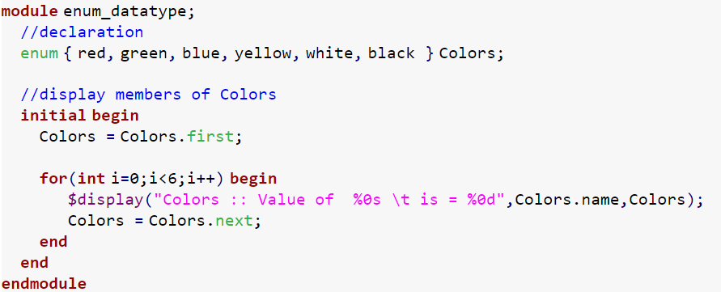
Data Types
Enumeration– Example1:
Colors :: Value of red is = 0 Colors :: Value of green is = 1 Colors :: Value of blue is = 2 Colors :: Value of yellow is = 3 Colors :: Value of white is = 4 Colors :: Value of black is = 5
Notes:
module enum_datatype;
//declaration
enum { red, green, blue, yellow, white, black } Colors;
//display members of Colors
initial begin
Colors = Colors.first;
for(int i=0;i&amp;amp;amp;amp;amp;amp;amp;amp;amp;lt;6;i++) begin
$display("Colors :: Value of %0s \t is = %0d",Colors.name,Colors);
Colors = Colors.next;
end
end
endmodule

Slide 24
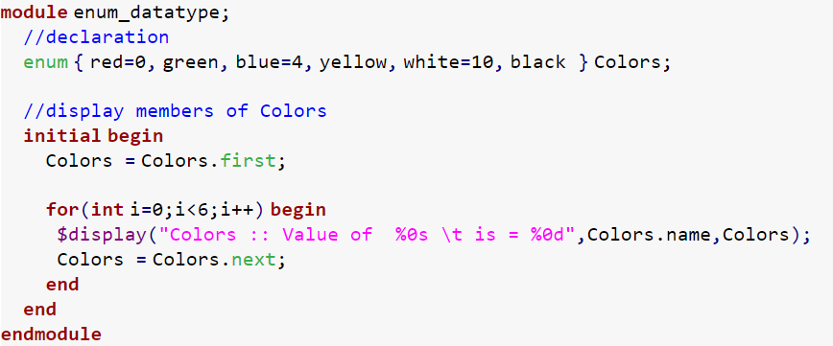
Data Types
Enumeration– Example2:
Colors :: Value of red is = 0 Colors :: Value of green is = 1 Colors :: Value of blue is = 4 Colors :: Value of yellow is = 5 Colors :: Value of white is = 10 Colors :: Value of black is = 11
Notes:
module enum_datatype;
//declaration
enum { red=0, green, blue=4, yellow, white=10, black } Colors;
//display members of Colors
initial begin
Colors = Colors.first;
for(int i=0;i&amp;amp;amp;amp;amp;amp;amp;amp;amp;lt;6;i++) begin
$display("Colors :: Value of %0s \t is = %0d",Colors.name,Colors);
Colors = Colors.next;
end
end
endmodule

Slide 25
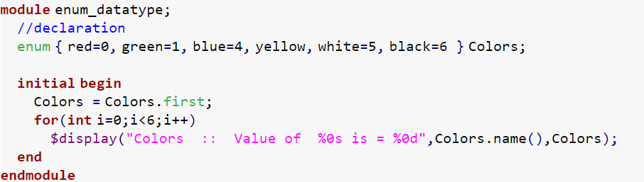
Data Types
Enumeration– Example3:
Error-[ENUMDUPL] Duplicate labels in enum testbench.sv, 9 The enum label 'white' has the value 5 which is duplicate of enum label 'yellow' in the declared enum.
Notes:
module enum_datatype;
//declaration
enum { red=0, green=1, blue=4, yellow, white=5, black=6 } Colors;
initial begin
Colors = Colors.first;
for(int i=0;i<6;i++)
$display("Colors :: Value of %0s is = %0d",Colors.name(),Colors);
end
endmodule

Slide 26
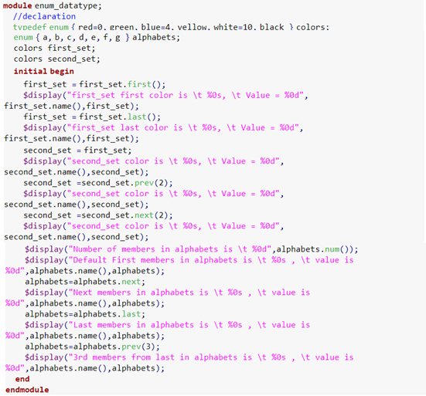
Quiz - 1
Notes:
// --- Code for Quiz 1 ---
module enum_datatype;
//declaration
typedef enum { red=0, green, blue=4, yellow, white=10, black } colors;
enum { a, b, c, d, e, f, g } alphabets;
colors first_set;
colors second_set;
initial begin
first_set = first_set.first();
$display("first_set first color is \t %0s, \t Value = %0d", first_set.name(),first_set);
first_set = first_set.last();
$display("first_set last color is \t %0s, \t Value = %0d", first_set.name(),first_set);
second_set = first_set;
$display("second_set color is \t %0s, \t Value = %0d", second_set.name(),second_set);
second_set =second_set.prev(2);
$display("second_set color is \t %0s, \t Value = %0d", second_set.name(),second_set);
second_set =second_set.next(2);
$display("second_set color is \t %0s, \t Value = %0d", second_set.name(),second_set);
$display("Number of members in alphabets is \t %0d",alphabets.num());
$display("Default First members in alphabets is \t %0s , \t value is %0d",alphabets.name(),alphabets);
alphabets=alphabets.next;
$display("Next members in alphabets is \t %0s , \t value is %0d",alphabets.name(),alphabets);
alphabets=alphabets.last;
$display("Last members in alphabets is \t %0s , \t value is %0d",alphabets.name(),alphabets);
alphabets=alphabets.prev(3);
$display("3rd members from last in alphabets is \t %0s , \t value is %0d",alphabets.name(),alphabets);
end
endmodule

Slide 27
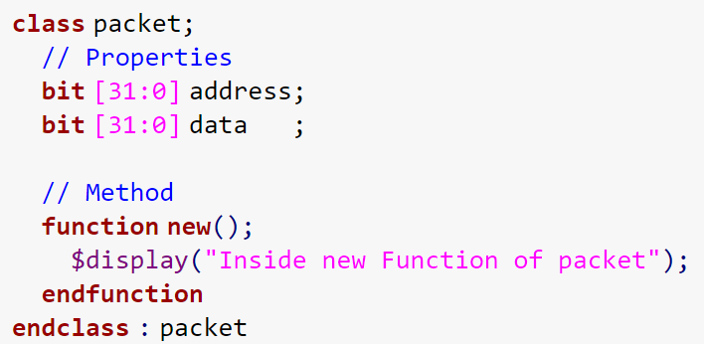
Data Types
A Class is a collection of data and a set of subroutines that operate on that data.
The data in a class are referred to as class properties
The subroutines are called methods

Slide 28
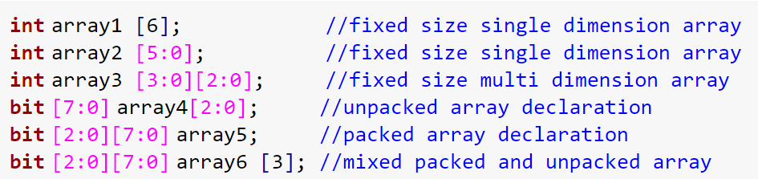
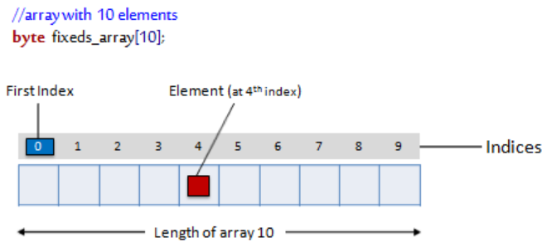
Data Types
Array:
Notes:
In System Verilog vector width/dimensions declared before the object name is referred to as packed array and array size/dimensions declared after the object name is referred to as an unpacked array.
A packed array is a mechanism for subdividing a vector into sub-fields which can be conveniently accessed as array elements.

Slide 29
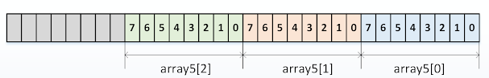
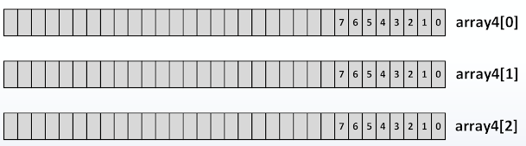
Data Types
Packed Array:
A packed array is a mechanism for subdividing a vector into sub-fields, which can be conveniently accessed as array elements.
bit [2:0] [7:0] array5;
Unpacked Array:
An unpacked array may or may not be so represented as a contiguous set of bits
bit [7:0] array4[2:0];

Slide 30


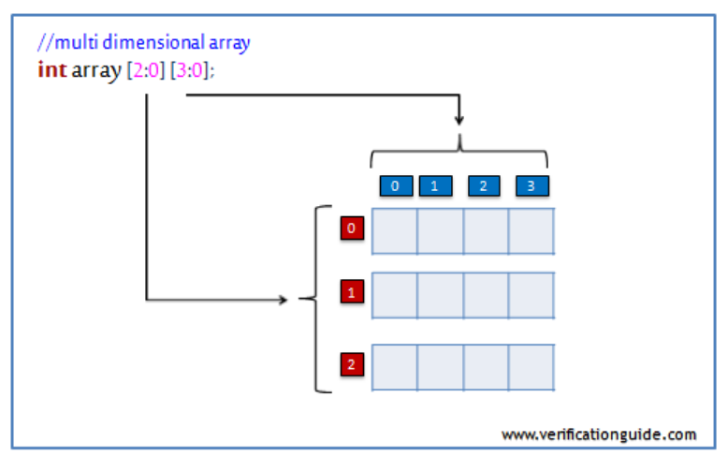

Data Types
Fixed size array → array size will be constant throughout the simulation

Slide 31
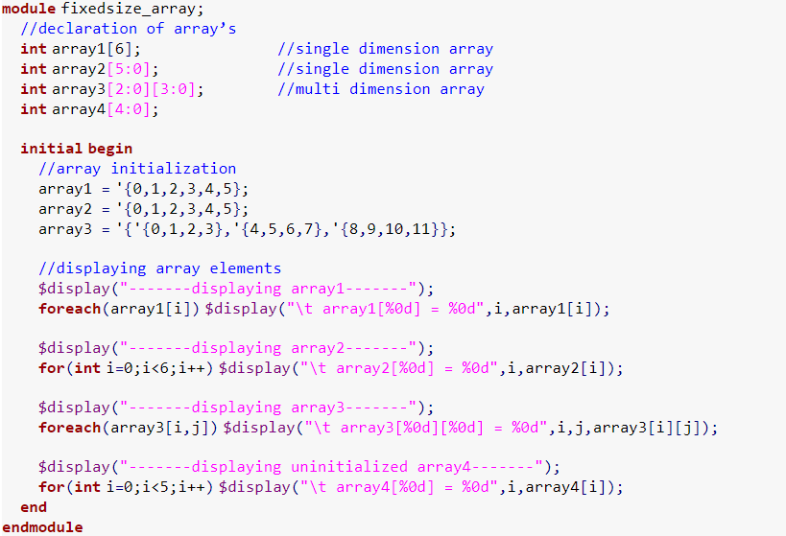
Data Types
-------displaying array1------- array1[0] = 0 array1[1] = 1 array1[2] = 2 array1[3] = 3 array1[4] = 4 array1[5] = 5
-------displaying array2------- array2[0] = 5 array2[1] = 4 array2[2] = 3 array2[3] = 2 array2[4] = 1 array2[5] = 0
Array - Example1:
-------displaying array3------- array3[2][3] = 0 array3[2][2] = 1 array3[2][1] = 2 array3[2][0] = 3 array3[1][3] = 4 array3[1][2] = 5 array3[1][1] = 6 array3[1][0] = 7 array3[0][3] = 8 array3[0][2] = 9 array3[0][1] = 10 array3[0][0] = 11
-------displaying uninitialized array4------- array4[0] = 0 array4[1] = 0 array4[2] = 0 array4[3] = 0 array4[4] = 0
Notes:
module fixedsize_array;
//declaration of array’s
int array1[6]; //single dimension array
int array2[5:0]; //single dimension array
int array3[2:0][3:0]; //multi dimension array
int array4[4:0];
initial begin
//array initialization
array1 = '{0,1,2,3,4,5};
array2 = '{0,1,2,3,4,5};
array3 = '{'{0,1,2,3},'{4,5,6,7},'{8,9,10,11}};
//displaying array elements
$display("-------displaying array1-------");
foreach(array1[i]) $display("\t array1[%0d] = %0d",i,array1[i]);
$display("-------displaying array2-------");
for(int i=0;i<6;i++) $display("\t array2[%0d] = %0d",i,array2[i]);
$display("-------displaying array3-------");
foreach(array3[i,j]) $display("\t array3[%0d][%0d] = %0d",i,j,array3[i][j]);
$display("-------displaying uninitialized array4-------");
for(int i=0;i<5;i++) $display("\t array4[%0d] = %0d",i,array4[i]);
end
endmodule

Slide 32


Data Types
Dynamic Array: size can be set or changed at run-time
The space for a dynamic array doesn’t exist until the array is explicitly created at run-time
Methods:

Slide 33
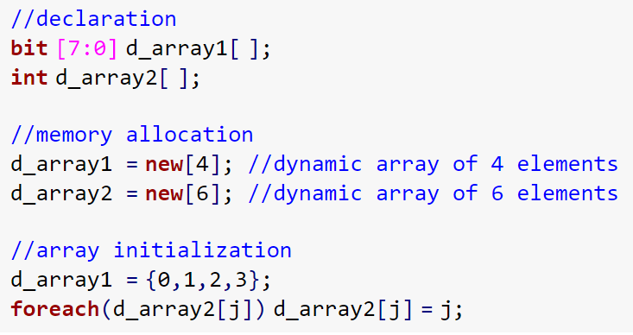
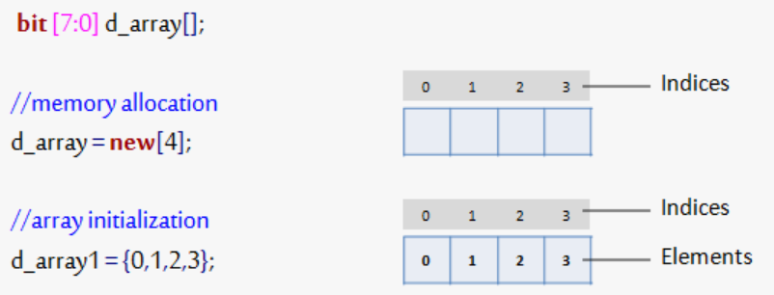
Data Types
Notes:
//declaration
bit [7:0] d_array1[ ];
int d_array2[ ];
//memory allocation
d_array1 = new[4]; //dynamic array of 4 elements
d_array2 = new[6]; //dynamic array of 6 elements
//array initialization
d_array1 = {0,1,2,3};
foreach(d_array2[j]) d_array2[j] = j;

Slide 34
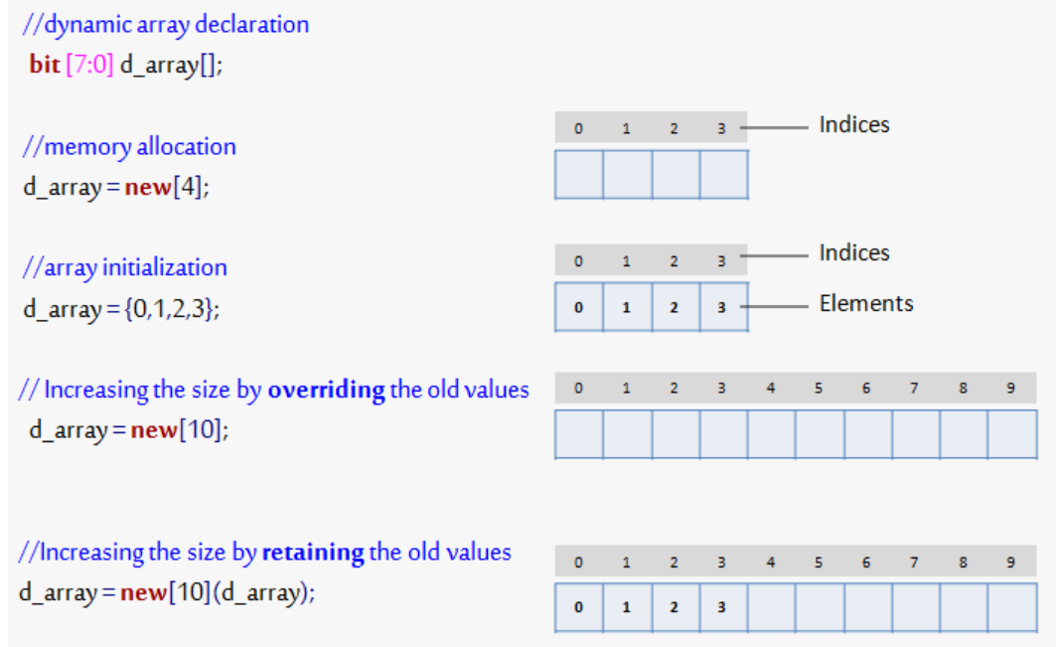
Data Types
Resize the array

Slide 35
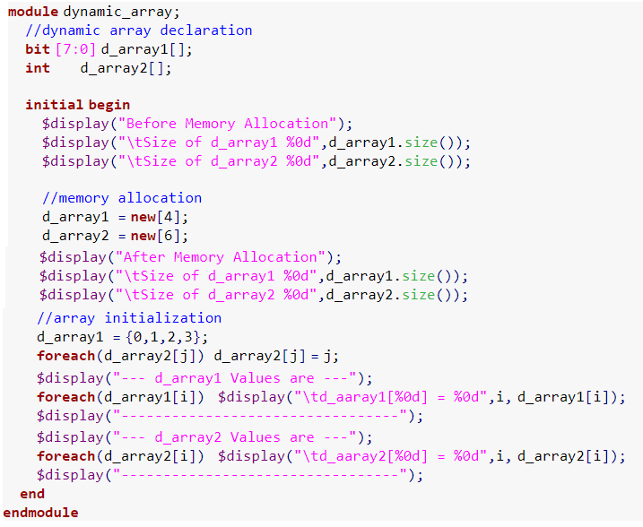
Data Types
Before Memory Allocation Size of d_array1 0 Size of d_array2 0 After Memory Allocation Size of d_array1 4 Size of d_array2 6 --- d_array1 Values are --- d_aaray1[0] = 0 d_aaray1[1] = 1 d_aaray1[2] = 2 d_aaray1[3] = 3 --------------------------------- --- d_array2 Values are --- d_aaray2[0] = 0 d_aaray2[1] = 1 d_aaray2[2] = 2 d_aaray2[3] = 3 d_aaray2[4] = 4 d_aaray2[5] = 5 ---------------------------------
Dynamic Array – Example1:
Notes:
module dynamic_array;
//dynamic array declaration
bit [7:0] d_array1[];
int d_array2[];
initial begin
$display("Before Memory Allocation");
$display("\tSize of d_array1 %0d",d_array1.size());
$display("\tSize of d_array2 %0d",d_array2.size());
//memory allocation
d_array1 = new[4];
d_array2 = new[6];
$display("After Memory Allocation");
$display("\tSize of d_array1 %0d",d_array1.size());
$display("\tSize of d_array2 %0d",d_array2.size());
//array initialization
d_array1 = {0,1,2,3};
foreach(d_array2[j]) d_array2[j] = j;
$display("--- d_array1 Values are ---");
foreach(d_array1[i]) $display("\td_aaray1[%0d] = %0d",i, d_array1[i]);
$display("---------------------------------");
$display("--- d_array2 Values are ---");
foreach(d_array2[i]) $display("\td_aaray2[%0d] = %0d",i, d_array2[i]);
$display("---------------------------------");
end
endmodule

Slide 36
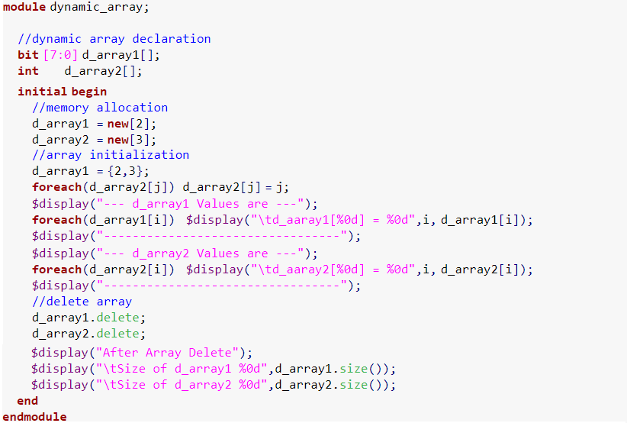
Data Types
Dynamic Array – Example2:
--- d_array1 Values are --- d_aaray1[0] = 2 d_aaray1[1] = 3 --------------------------------- --- d_array2 Values are --- d_aaray2[0] = 0 d_aaray2[1] = 1 d_aaray2[2] = 2 --------------------------------- After Array Delete Size of d_array1 0 Size of d_array2 0
Notes:
module dynamic_array;
//dynamic array declaration
bit [7:0] d_array1[];
int d_array2[];
initial begin
//memory allocation
d_array1 = new[2];
d_array2 = new[3];
//array initialization
d_array1 = {2,3};
foreach(d_array2[j]) d_array2[j] = j;
$display("--- d_array1 Values are ---");
foreach(d_array1[i]) $display("\td_aaray1[%0d] = %0d",i, d_array1[i]);
$display("---------------------------------");
$display("--- d_array2 Values are ---");
foreach(d_array2[i]) $display("\td_aaray2[%0d] = %0d",i, d_array2[i]);
$display("---------------------------------");
//delete array
d_array1.delete;
d_array2.delete;
$display("After Array Delete");
$display("\tSize of d_array1 %0d",d_array1.size());
$display("\tSize of d_array2 %0d",d_array2.size());
end
endmodule

Slide 37
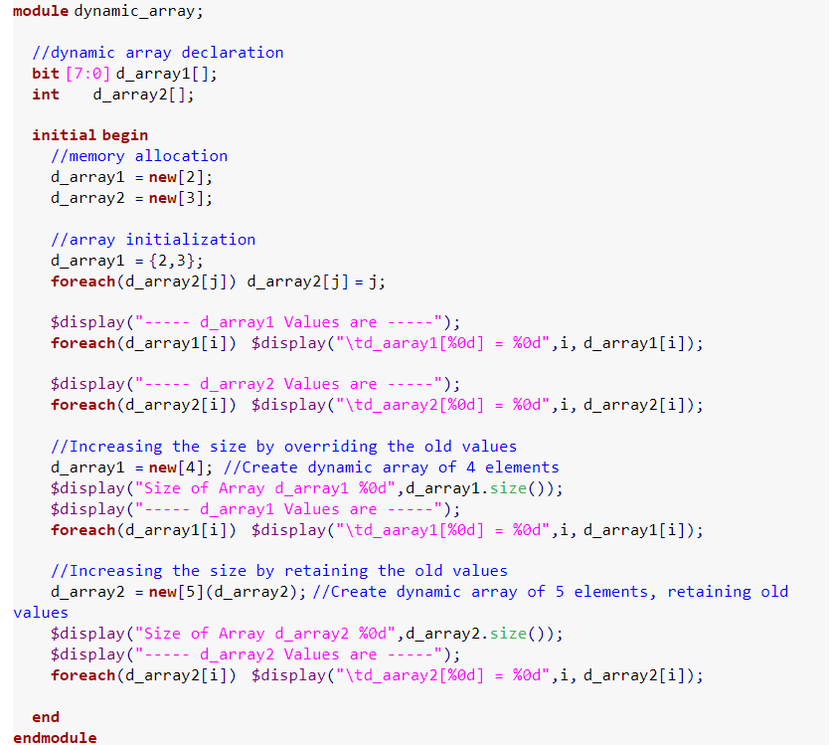
Quiz -2
Notes:
module dynamic_array;
//dynamic array declaration
bit [7:0] d_array1[];
int d_array2[];
initial begin
//memory allocation
d_array1 = new[2];
d_array2 = new[3];
//array initialization
d_array1 = {2,3};
foreach(d_array2[j]) d_array2[j] = j;
$display("----- d_array1 Values are -----");
foreach(d_array1[i]) $display("\td_aaray1[%0d] = %0d",i, d_array1[i]);
$display("----- d_array2 Values are -----");
foreach(d_array2[i]) $display("\td_aaray2[%0d] = %0d",i, d_array2[i]);
//Increasing the size by overriding the old values
d_array1 = new[4]; //Create dynamic array of 4 elements
$display("Size of Array d_array1 %0d",d_array1.size());
$display("----- d_array1 Values are -----");
foreach(d_array1[i]) $display("\td_aaray1[%0d] = %0d",i, d_array1[i]);
//Increasing the size by retaining the old values
d_array2 = new[5](d_array2); //Create dynamic array of 5 elements, retaining old values
$display("Size of Array d_array2 %0d",d_array2.size());
$display("----- d_array2 Values are -----");
foreach(d_array2[i]) $display("\td_aaray2[%0d] = %0d",i, d_array2[i]);
end
endmodule

Slide 38
Queues
Queue: has a variable size just as dynamic arrays but can support inserting and removing elements anywhere.
Queue Methods:
size() --> returns the number of items in the queue.
insert() --> inserts the given item at the specified index position.
delete() --> deletes the item at the specified index position.
push_front() --> inserts the given element at the front of the queue.
push_back() --> inserts the given element at the end of the queue.
pop_front() --> removes and returns the first element of the queue.
pop_back() --> removes and returns the last element of the queue.
Notes:
A queue is a variable-size, ordered collection of homogeneous elements.
like a dynamic array, queues can grow and shrink
queue supports adding and removing elements anywhere
A queue can be bounded or unbounded.
bounded queue – queue with the number of entries limited or queue size specified
unbounded queue – queue with unlimited entries or queue size not specified
Queues are declared using the same syntax as unpacked arrays, but specifying $ as the array size. In queue 0 represents the first, and $ representing the last entries.

Slide 39
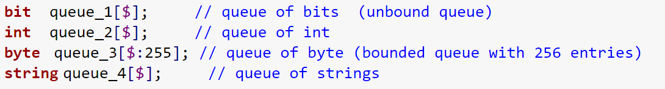

Queues
Declaration

Slide 40
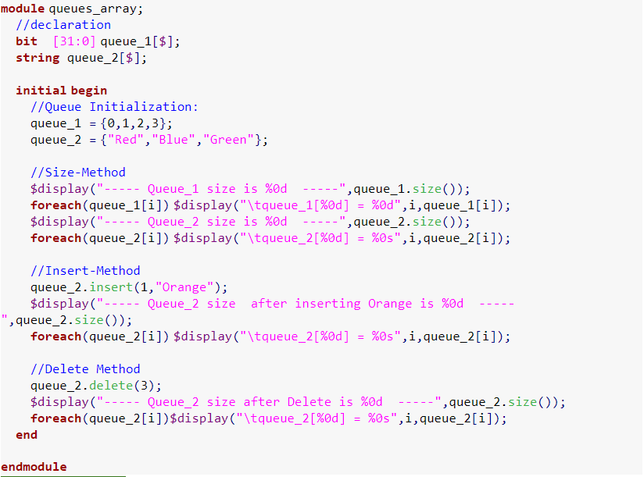
Queues
----- Queue_1 size Is 4 ----- queue_1[0] = 0 queue_1[1] = 1 queue_1[2] = 2 queue_1[3] = 3
----- Queue_2 size is 3 ----- queue_2[0] = Red queue_2[1] = Blue queue_2[2] = Green
----- Queue_2 size after inserting Orange is 4 ----- queue_2[0] = Red queue_2[1] = Orange queue_2[2] = Blue queue_2[3] = Green
----- Queue_2 size after Delete is 3 ----- queue_2[0] = Red queue_2[1] = Orange queue_2[2] = Blue
Notes:
module queues_array;
//declaration
bit [31:0] queue_1[$]; //unbounded queue
string queue_2[$];
initial begin
//Queue Initialization:
queue_1 = {0,1,2,3};
queue_2 = {"Red","Blue","Green"};
//Size-Method
$display("----- Queue_1 size is %0d -----",queue_1.size());
foreach(queue_1[i]) $display("\tqueue_1[%0d] = %0d",i,queue_1[i]);
$display("----- Queue_2 size is %0d -----",queue_2.size());
foreach(queue_2[i]) $display("\tqueue_2[%0d] = %0s",i,queue_2[i]);
//Insert-Method
queue_2.insert(1,"Orange");
$display("----- Queue_2 size after inserting Orange is %0d -----",queue_2.size());
foreach(queue_2[i]) $display("\tqueue_2[%0d] = %0s",i,queue_2[i]);
//Delete Method
queue_2.delete(3);
$display("----- Queue_2 size after Delete is %0d -----",queue_2.size());
foreach(queue_2[i])$display("\tqueue_2[%0d] = %0s",i,queue_2[i]);
end
endmodule

Slide 41
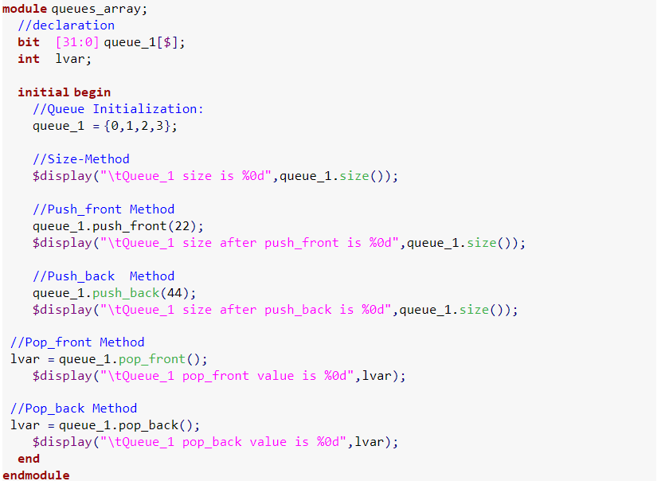
Quiz - 3
Notes:
module queues_array;
//declaration
bit [31:0] queue_1[$];
int lvar;
initial begin
//Queue Initialization:
queue_1 = {0,1,2,3};
//Size-Method
$display("\tQueue_1 size is %0d",queue_1.size());
//Push_front Method
queue_1.push_front(22);
$display("\tQueue_1 size after push_front is %0d",queue_1.size());
//Push_back Method
queue_1.push_back(44);
$display("\tQueue_1 size after push_back is %0d",queue_1.size());
//Pop_front Method
lvar = queue_1.pop_front();
$display("\tQueue_1 pop_front value is %0d",lvar);
//Pop_back Method
lvar = queue_1.pop_back();
$display("\tQueue_1 pop_back value is %0d",lvar);
end
endmodule

Slide 42
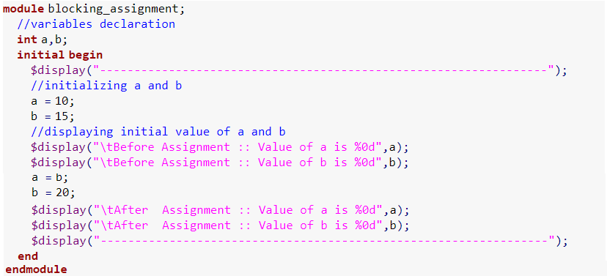
Procedural Statements and Control Flow
Blocking Assignment: statements executes in series order. Blocking assignment blocks the execution of next statement until the completion of current assignment execution.
------------------------------------------------------ Before Assignment :: Value of a is 10 Before Assignment :: Value of b is 15 After Assignment :: Value of a is 15 After Assignment :: Value of b is 20 ------------------------------------------------------
Notes:
n Below Example, a and b is initialized with value 10 and 15 respectively, after that b is being assigned to a (a value will become 15), and value 20 is assigned to b. After assignment value of a = 15 and b=20.

Slide 43
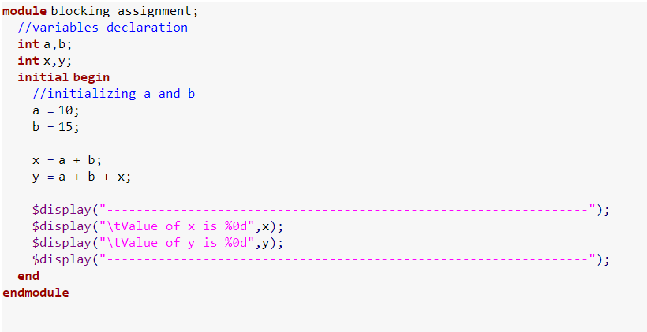
Quiz - 4
Notes:
module blocking_assignment;
//variables declaration
int a,b;
int x,y;
initial begin
//initializing a and b
a = 10;
b = 15;
x = a + b;
y = a + b + x;
$display("-----------------------------------------------------------------");
$display("\tValue of x is %0d",x);
$display("\tValue of y is %0d",y);
$display("-----------------------------------------------------------------");
end
endmodule

Slide 44

Procedural Statements and Control Flow
Non Blocking Assignments:
statements executes in parallel.
All the assignments will occur at the same time (during the end of simulation timestamp).

Slide 45
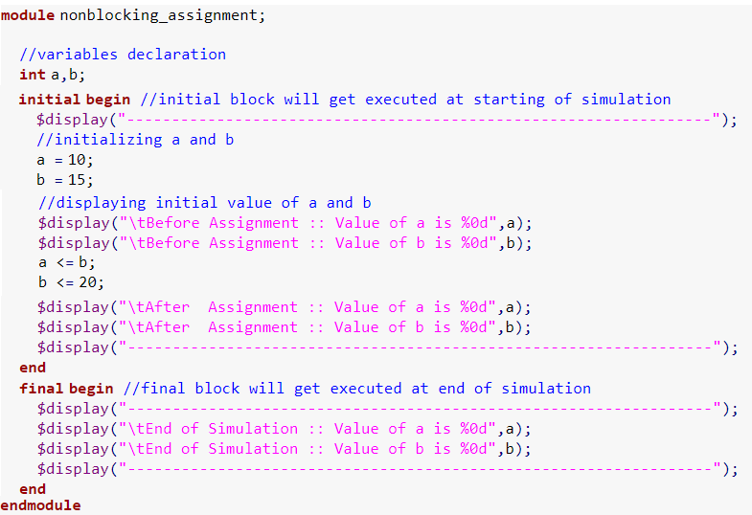
Procedural Statements and Control Flow
Non-Blocking Assignments:
---------------------------------------------------------------
Before Assignment :: Value of a is 10
Before Assignment :: Value of b is 15
After Assignment :: Value of a is 10
After Assignment :: Value of b is 15
---------------------------------------------------------------
---------------------------------------------------------------
End of Simulation :: Value of a is 15
End of Simulation :: Value of b is 20
---------------------------------------------------------------
Notes:
module nonblocking_assignment;
//variables declaration
int a,b;
initial begin //initial block will get executed at starting of simulation
$display("-----------------------------------------------------------------");
//initializing a and b
a = 10;
b = 15;
//displaying initial value of a and b
$display("\tBefore Assignment :: Value of a is %0d",a);
$display("\tBefore Assignment :: Value of b is %0d",b);
a <= b;
b <= 20;
$display("\tAfter Assignment :: Value of a is %0d",a);
$display("\tAfter Assignment :: Value of b is %0d",b);
$display("-----------------------------------------------------------------");
end
final begin //final block will get executed at end of simulation
$display("-----------------------------------------------------------------");
$display("\tEnd of Simulation :: Value of a is %0d",a);
$display("\tEnd of Simulation :: Value of b is %0d",b);
$display("-----------------------------------------------------------------");
end
endmodule

Slide 46
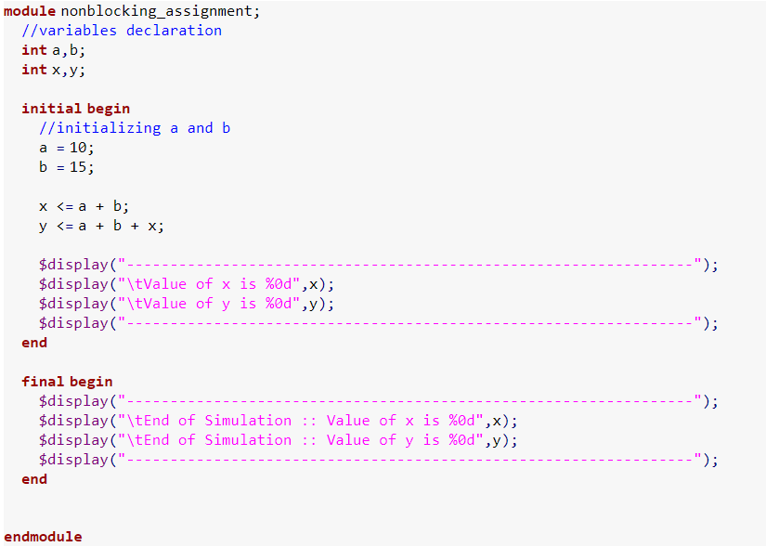
Quiz - 5
Notes:
module nonblocking_assignment;
//variables declaration
int a,b;
int x,y;
initial begin
//initializing a and b
a = 10;
b = 15;
x <= a + b;
y <= a + b + x;
$display("-----------------------------------------------------------------");
$display("\tValue of x is %0d",x);
$display("\tValue of y is %0d",y);
$display("-----------------------------------------------------------------");
end
final begin
$display("-----------------------------------------------------------------");
$display("\tEnd of Simulation :: Value of x is %0d",x);
$display("\tEnd of Simulation :: Value of y is %0d",y);
$display("-----------------------------------------------------------------");
end
endmodule

Slide 47
Procedural Statements and Control Flow
Unique If: evaluates all the conditions parallel
simulator issue a run time error/warning in following conditions:
More than one condition is true
No condition is true or final if doesn't have corresponding else

Slide 48
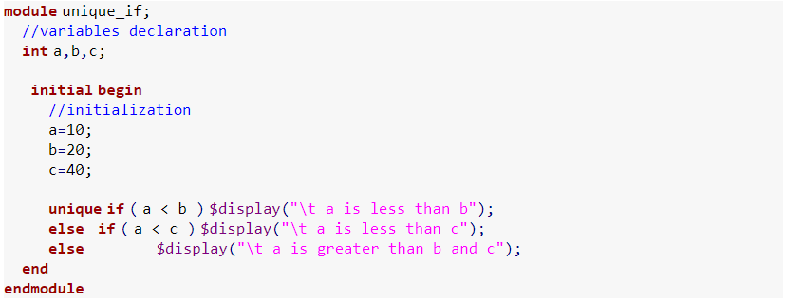
Procedural Statements and Control Flow
Unique If – Example 1:
a is less than b
RT Warning: More than one conditions match in 'unique if' statement.
Notes:
module unique_if;
//variables declaration
int a,b,c;
initial begin
//initialization
a=10;
b=20;
c=40;
unique if ( a < b ) $display("\t a is less than b");
else if ( a < c ) $display("\t a is less than c");
else $display("\t a is greater than b and c");
end
endmodule

Slide 49
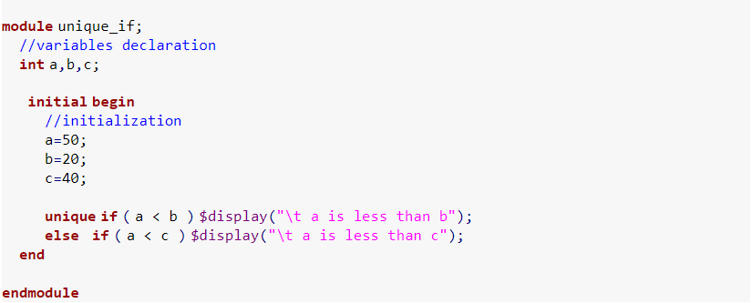
Procedural Statements and Control Flow
Unique If – Example 2:
RT Warning: No condition matches in 'unique if' statement
Notes:
module unique_if;
//variables declaration
int a,b,c;
initial begin
//initialization
a=50;
b=20;
c=40;
unique if ( a < b ) $display("\t a is less than b");
else if ( a < c ) $display("\t a is less than c");
end
endmodule

Slide 50
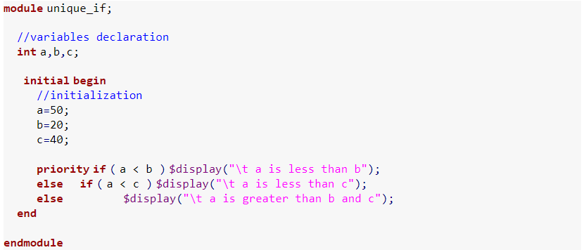
Quiz - 6
Notes:
module unique_if;
//variables declaration
int a,b,c;
initial begin
//initialization
a=50;
b=20;
c=40;
priority if ( a < b ) $display("\t a is less than b");
else if ( a < c ) $display("\t a is less than c");
else $display("\t a is greater than b and c");
end
endmodule

Slide 51
Procedural Statements and Control Flow
Priority If: evaluates all the conditions in sequential order
simulator issue a run time error/warning in following case:
No condition is true or final if doesn't have corresponding else

Slide 52

Procedural Statements and Control Flow
Priority If – Example1:
a is less than b
Notes:
module priority_if;
//variables declaration
int a,b,c;
initial begin
//initialization
a=10;
b=20;
c=40;
priority if ( a < b ) $display("\t a is less than b");
else if ( a < c ) $display("\t a is less than c");
else $display("\t a is greater than b and c");
end
endmodule

Slide 53
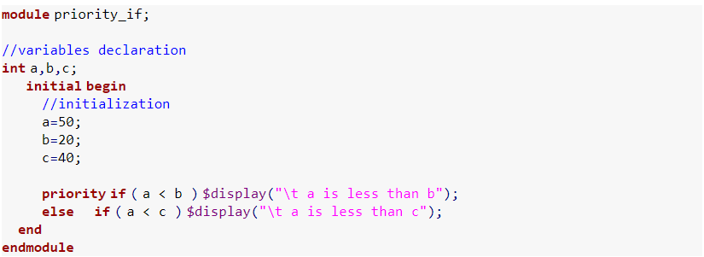
Quiz 7
Notes:
module priority_if;
//variables declaration
int a,b,c;
initial begin
//initialization
a=50;
b=20;
c=40;
priority if ( a < b ) $display("\t a is less than b");
else if ( a < c ) $display("\t a is less than c");
end
endmodule

Slide 54
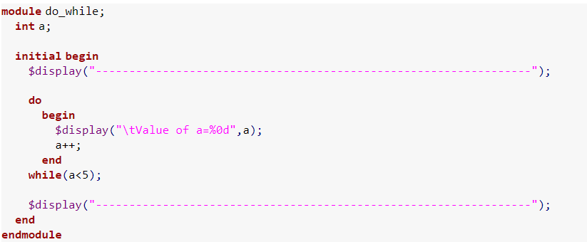
Procedural Statements and Control Flow
Do While loop: is a control flow statement that allows code to be executed repeatedly based on a given condition. In do-while, condition will be checked after the execution of statements inside the loop, condition can be any expression.
------------------------------------------------------- Value of a=0 Value of a=1 Value of a=2 Value of a=3 Value of a=4 -------------------------------------------------------
Notes:
module do_while;
int a;
initial begin
$display("-----------------------------------------------------------------");
do
begin
$display("\tValue of a=%0d",a);
a++;
end
while(a<5);
$display("-----------------------------------------------------------------");
end
endmodule

Slide 55
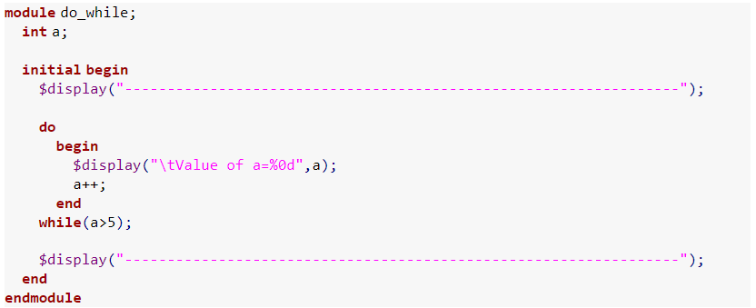
Quiz 8
Notes:
module do_while;
int a;
initial begin
$display("-----------------------------------------------------------------");
do
begin
$display("\tValue of a=%0d",a);
a++;
end
while(a>5);
$display("-----------------------------------------------------------------");
end
endmodule

Slide 56
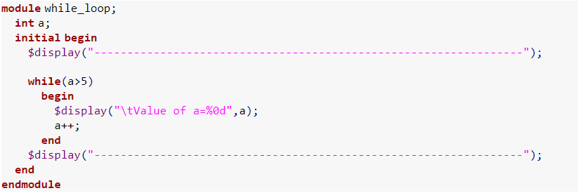
Procedural Statements and Control Flow
While Loop: is a control flow statement that allows code to be executed repeatedly based on a given condition. Execution of statements within the loop happens only if the condition is true.
----------------------------------------------------------------- -----------------------------------------------------------------
Notes:
module while_loop;
int a;
initial begin
$display("-----------------------------------------------------------------");
while(a>5)
begin
$display("\tValue of a=%0d",a);
a++;
end
$display("-----------------------------------------------------------------");
end
endmodule

Slide 57
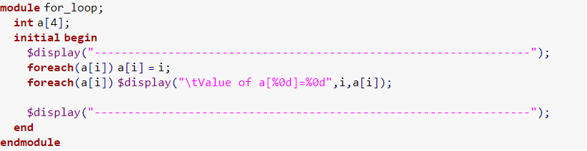
Procedural Statements and Control Flow
For-each loop:
------------------------------------------------- Value of a[0]=0 Value of a[1]=1 Value of a[2]=2 Value of a[3]=3 --------------------------------------------------
Notes:
module for_loop;
int a[4];
initial begin
$display("-----------------------------------------------------------------");
foreach(a[i]) a[i] = i;
foreach(a[i]) $display("\tValue of a[%0d]=%0d",i,a[i]);
$display("-----------------------------------------------------------------");
end
endmodule

Slide 58
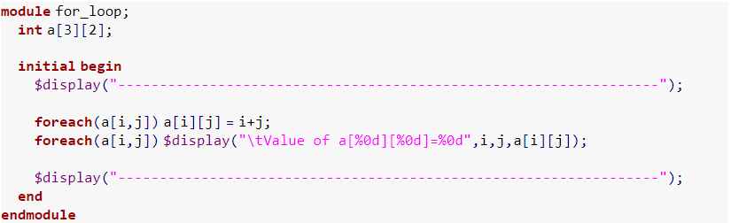
Procedural Statements and Control Flow
For-each loop:
----------------------------------------------------- Value of a[0][0]=0 Value of a[0][1]=1 Value of a[1][0]=1 Value of a[1][1]=2 Value of a[2][0]=2 Value of a[2][1]=3 -----------------------------------------------------
Notes:
module for_loop;
int a[3][2];
initial begin
$display("-----------------------------------------------------------------");
foreach(a[i,j]) a[i][j] = i+j;
foreach(a[i,j]) $display("\tValue of a[%0d][%0d]=%0d",i,j,a[i][j]);
$display("-----------------------------------------------------------------");
end
endmodule

Slide 59
Procedural Statements and Control Flow
Break:
------------------------------------------------- Value of i=0 Value of i=1 Value of i=2 Value of i=3 Value of i=4 Calling break, -------------------------------------------------
Notes:
SystemVerilog for loop allows,
declaration of a loop variable within the for loop
one or more initial declaration or assignment within the for loop
one or more step assignment or modifier within the for loop
Initialization: executed first, and only once. This allows the user to declare and initialize loop control variables.
Condition: the condition is evaluated. If it is true, the body of the loop is executed, else the flow jumps to the statement after the ‘for’ loop.
Modifier: at the end of each iteration it will be executed, and execution moves to Condition.
module break_in_loop;
initial begin
$display("-----------------------------------------------------------------");
for(int i=0;i<8;i++) begin
$display("\tValue of i=%0d",i);
if(i == 4) begin
$display("\tCalling break,");
break;
end
end
$display("-----------------------------------------------------------------");
end
endmodule

Slide 60
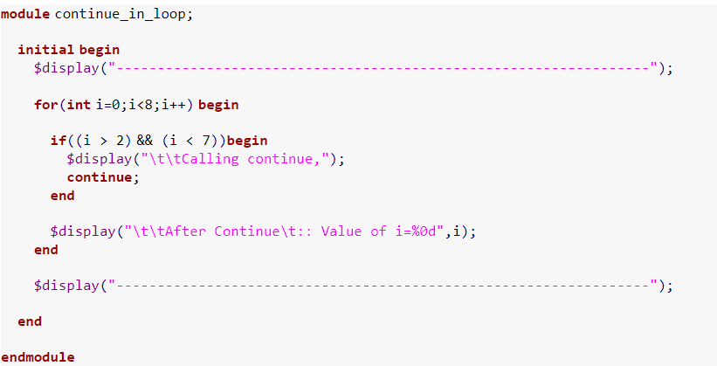
Procedural Statements and Control Flow
Continue:
------------------------------------------------------- After Continue :: Value of i=0 After Continue :: Value of i=1 After Continue :: Value of i=2 Calling continue, Calling continue, Calling continue, Calling continue, After Continue :: Value of i=7 --------------------------------------------------------
Notes:
module continue_in_loop;
initial begin
$display("-----------------------------------------------------------------");
for(int i=0;i<8;i++) begin
if((i > 2) && (i < 7))begin
$display("\t\tCalling continue,");
continue;
end
$display("\t\tAfter Continue\t:: Value of i=%0d",i);
end
$display("-----------------------------------------------------------------");
end
endmodule

Slide 61
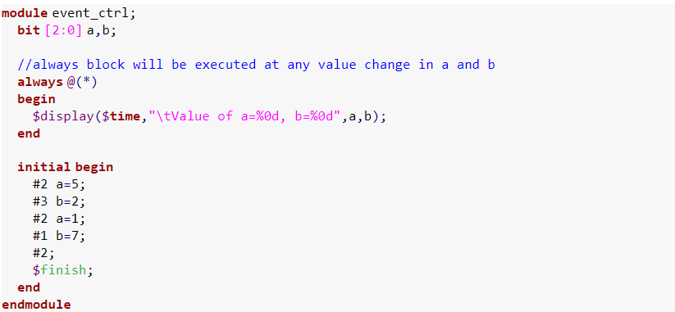
Procedural Statements and Control Flow
Event Control: Any change in a variable or net can be detected using the @ event control.
2 Value of a=5, b=0 5 Value of a=5, b=2 7 Value of a=1, b=2 8 Value of a=1, b=7 $finish called from file "testbench.sv", line 27. $finish at simulation time 10

Slide 62
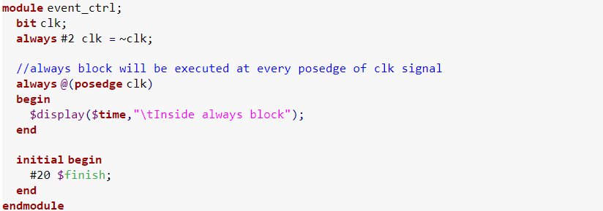
Procedural Statements and Control Flow
Event Control:
2 Inside always block 6 Inside always block 10 Inside always block 14 Inside always block 18 Inside always block $finish called from file "testbench.sv", line 24. $finish at simulation time 20

Slide 63
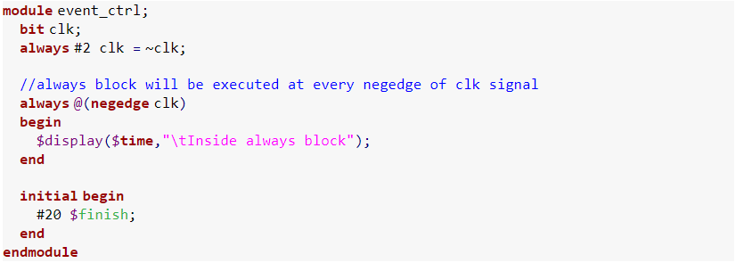
Quiz - 9

Slide 64
Processes
Fork – Join:

Slide 65
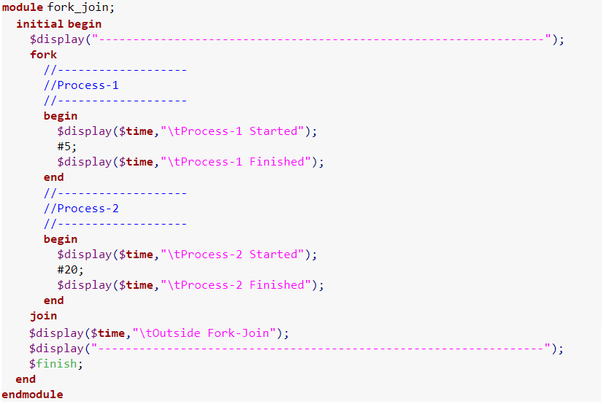
Processes
Fork – Join:
--------------------------------- 0 Process-1 Started 0 Process-2 Started 5 Process-1 Finished 20 Process-2 Finished 20 Outside Fork-Join ---------------------------------

Slide 66
Processes
Fork Join_any:

Slide 67
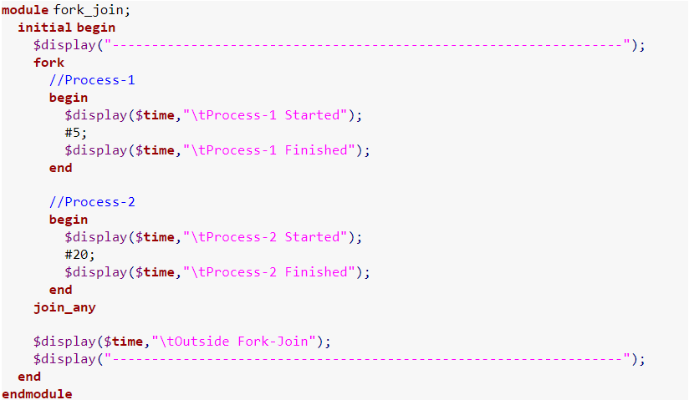
Processes
Fork Join_any:
--------------------------------------- 0 process-1 Started 0 process-2 Started 5 process-1 Finished 5 outside Fork-Join ----------------------------------------
20 Process-2 Finished

Slide 68
Processes
Fork Join_none:

Slide 69

Processes
---------------------------------------------------- 0 Process-1 Started 0 Process-2 Started
0 Outside Fork Join_none ---------------------------------------------------- 5 Process-1 Finished 20 Process-2 Finished

Slide 70

Processes
Fork Join Any:
------------------------------------------------------ 0 Process-1 Started 0 Process-2 Started 5 Process-1 Finished ------------------------------------------------------

Slide 71

Processes
-------------------------------------- 0 Process-1 Started 0 Process-2 Started 5 Process-1 Finished 20 Process-2 Finished -------------------------------------

Slide 72

Processes
Disable Fork
------------------------------------------- 0 Process-1 of fork-1 Started 0 Sub-Process Started 5 Process-1 of fork-1 Finished -------------------------------------------- 5 After disable-fork --------------------------------------------

Slide 73

Tasks
A Task can contain a declaration of parameters, input arguments, output arguments, in-out arguments, registers, events and zero or more behavioural statements.
Value of x=15

Slide 74

Tasks
Value of x = 15

Slide 75
Functions
A Function can contain declarations of range, returned type, parameters, input arguments, registers and events. A function without a range or return type declaration, returns a one-bit value
Any expression can be used as a function call argument. Functions cannot contain any time-controlled statements, and they cannot enable tasks. Functions can return only one value.

Slide 76

Functions
Value of x = 15

Slide 77

Functions
Value of x = 15

Slide 78
Tasks Vs. Functions
A function must execute in one simulation time unit; a task can contain time-controlling statements.
A function cannot enable a task; a task can enable other tasks and functions.
A function must have at least one input argument; a task can have zero or more arguments of any type.
A function returns a single value; a task does not return a value.

Slide 79


System Verilog Simulation time units
Time unit / Precision

Slide 80

Testing Environment

Slide 81
Session one Task
Build a complete ALU using System Verilog based on the coding techniques discussed in this session

Slide 82
Thank you
Reference: Verification Guide
https://www.verificationguide.com/p/home.html

